Slide 1
BRITISH AIRWAYS
WEB SCRAPPING TO GET INSIGHTS OF DATA

Slide 2
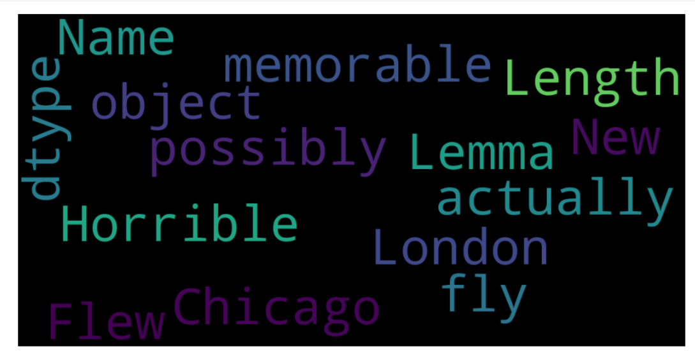
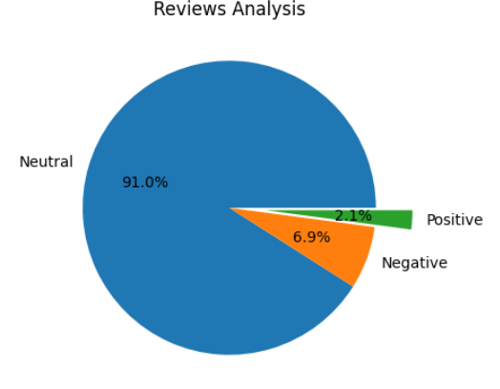
CUSTOMER REVIEWS INSIGHTS
From 10 web scrapping pages did cleaning of 1000 reviews given by customers
Positive reviews 21
Negative reviews 69
Neutral reviews 910

